Slide 1
Stat 495r – Presenting Data
Week 11 – Densities and non-standard visualizations

Slide 2

Announcements
Max Larsen Parker
Tableau follow-up
Agenda for the rest of the year
RShiny
Interactivity
Labeling ggplots
Maps
Last day will by some Python
1.5 more homeworks (none today)
No final or tests

Slide 3
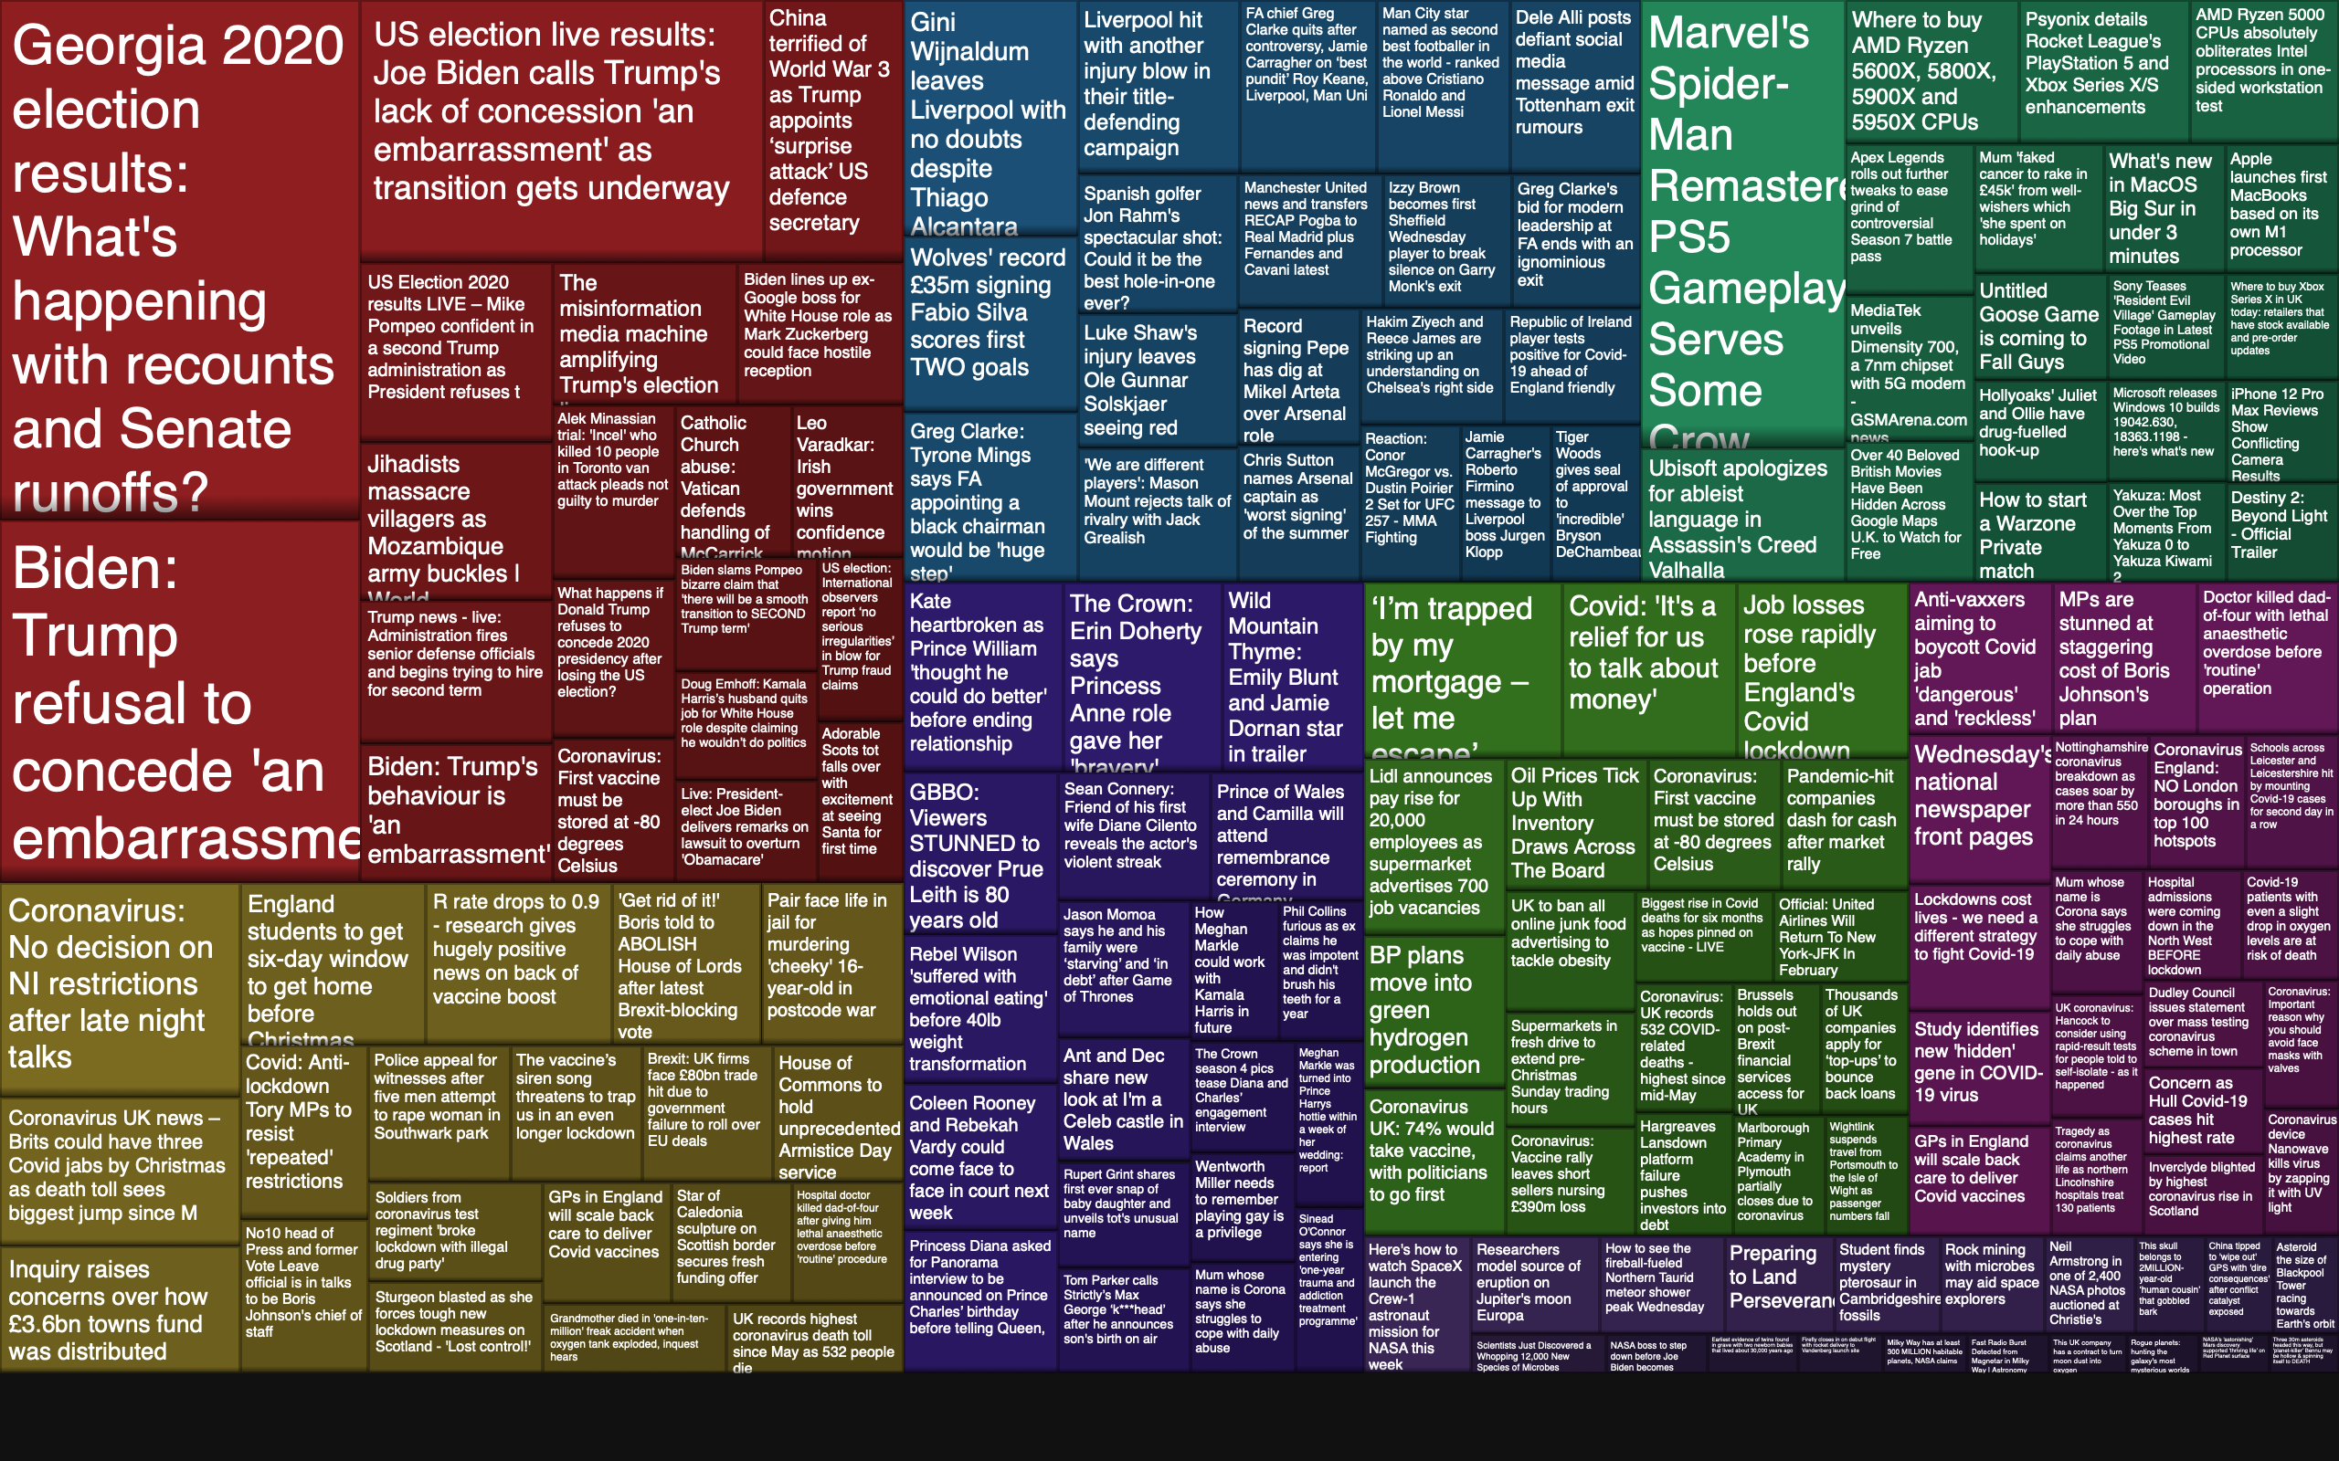
Data Viz #1
Notes:
This is called a tree map
What aesthetics are used?
When else can tree maps be usefule?

Slide 4
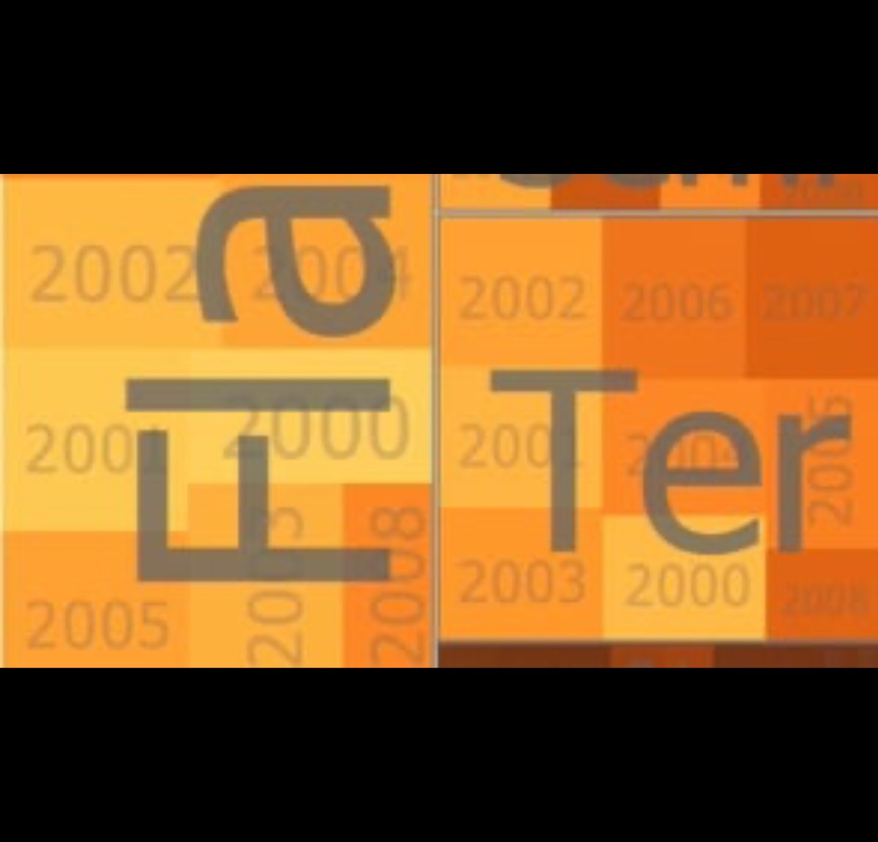
Data Viz #2
Notes:
Warning: English accent: “Borough”
How can iterations with new aesthetics improve visuals and storytelling?

Slide 5
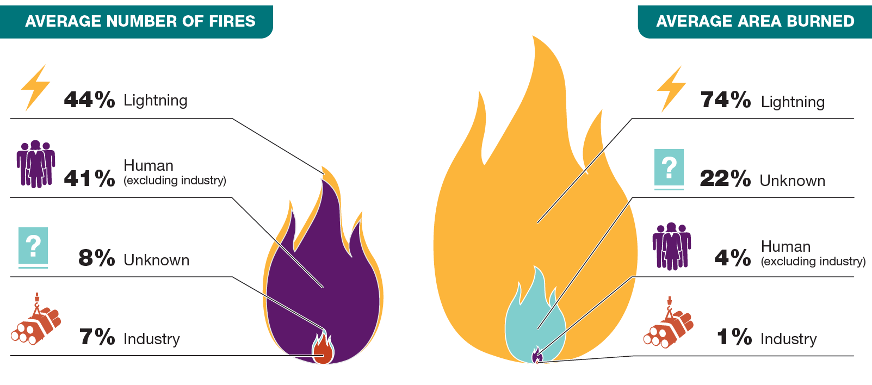
Data Viz #3
Notes:
What’s wrong?
What is the aesthetic?
Without thinking about it, what is the takeaway? “Humans cause the most fires, but lightning burns the most area”

Slide 6
Quote of the Week To cut or not to cut?
In general, in a time-series, use a baseline that shows the data not the zero point
Notes:
Consider this when removing chart junk

Slide 7
The Power 6 Types of Charts
Table
Simple Text
 | A | B | C
Rev | $5 | $10 | $15
Cost | $4 | $3 | $7
Tot | $1 | $7 | $8
91%
Notes:
Charts vs Graph

Slide 8
Density Charts

Slide 9
Averages are Dangerous!!!
$607,760
$364,599
Average House price in Wasatch County
Median House price in Wasatch County
library(tidyverse)
houses <- read_csv("BYU/Week 11 - html widgets/cleaned_parcels.csv")
houses <- houses %>%
select(parcel_number, property_add, market_value, year_built) %>%
separate(property_add, c("address", "city"), sep = ",") %>%
mutate(city = trimws(city)) %>%
filter(market_value > 0,
year_built > 0,
city %in% c("WOODLAND", "STRAWBERRY", "MIDWAY", "KAMAS", "HEBER"))
Notes:
My advice, never look at the average. People misunderstand this.
Averages are misleading
Always look at the full distribution

Slide 10
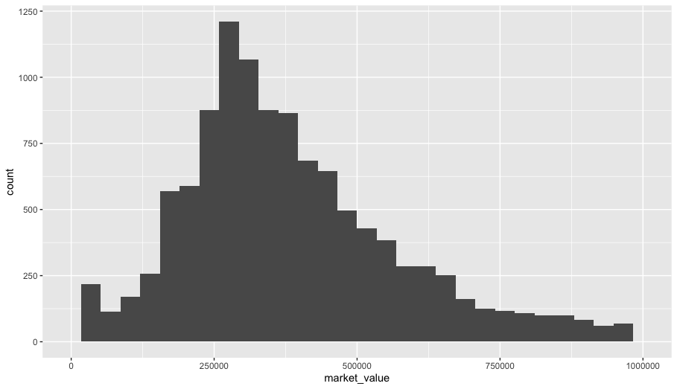
Histogram
ggplot(houses) +
geom_histogram(aes(x = market_value)) +
xlim(0, 1000000)
Notes:
What’s the mode?

Slide 11
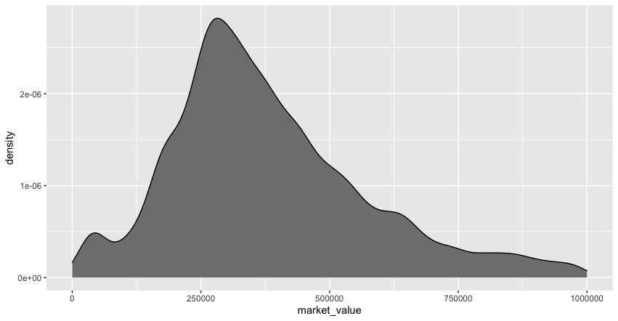
Density
ggplot(houses) +
geom_density(aes(x = market_value), fill = "grey50") +
xlim(0, 1000000)

Slide 12
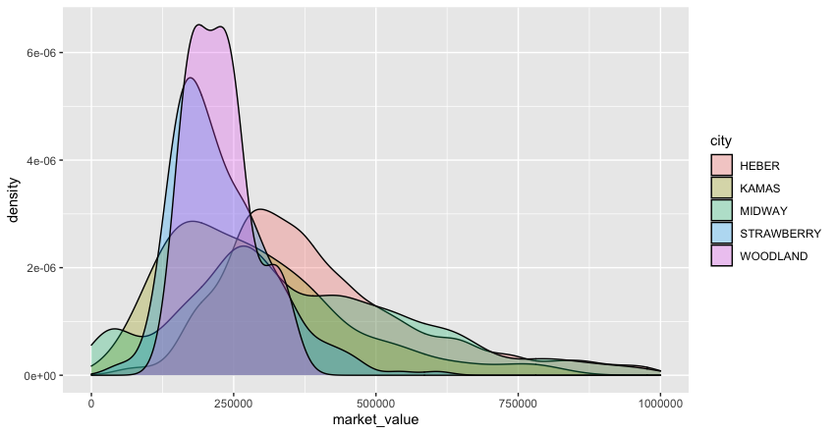
Multiple Densities
ggplot(houses) +
geom_density(aes(x = market_value, fill = city), alpha = 0.3) +
xlim(0, 1000000)

Slide 13
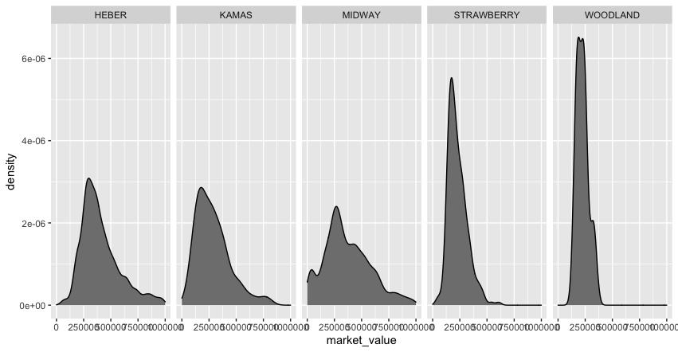
Multiples using facets
ggplot(houses) +
geom_density(aes(x = market_value), fill = "grey50") +
facet_grid(~city) +
xlim(0, 1000000)

Slide 14
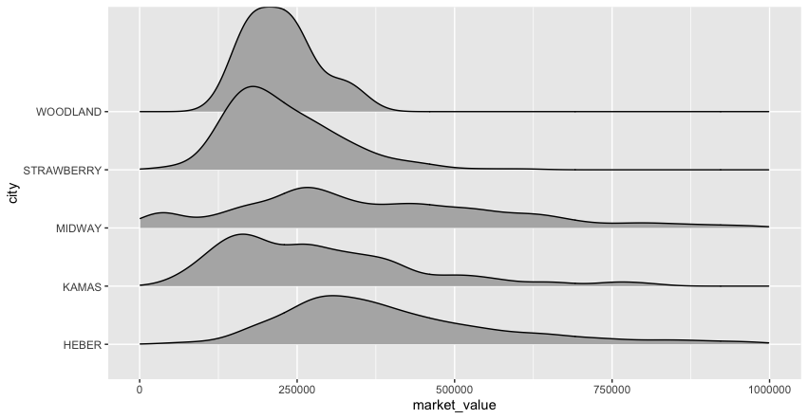
Ridgeline
install.packages("ggridges")
library(ggridges)
ggplot(houses) +
geom_density_ridges(aes(y = city, x = market_value)) +
xlim(0, 1000000)
Notes:
What would make this better? Order the cities

Slide 15
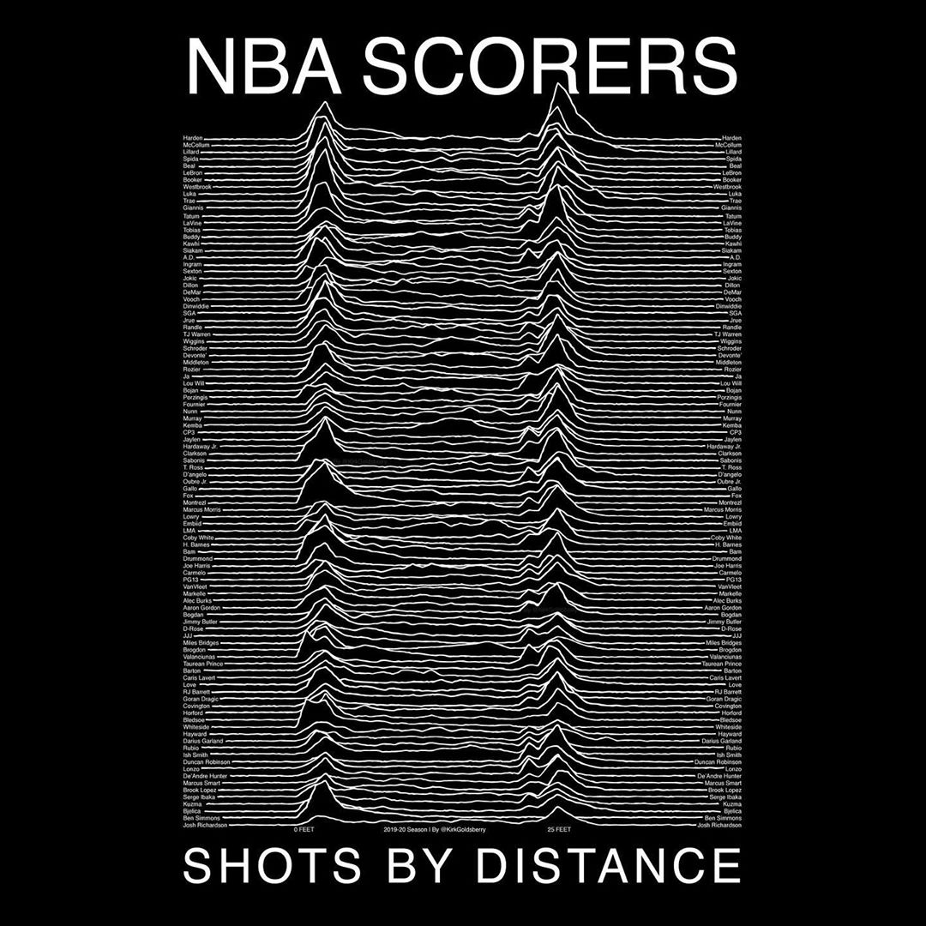

Slide 16
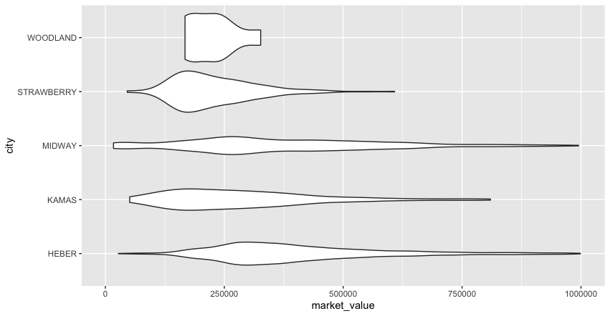
Violin
ggplot(houses) +
geom_violin(aes(x = city, y = market_value)) +
ylim(0, 1000000) +
coord_flip()

Slide 17
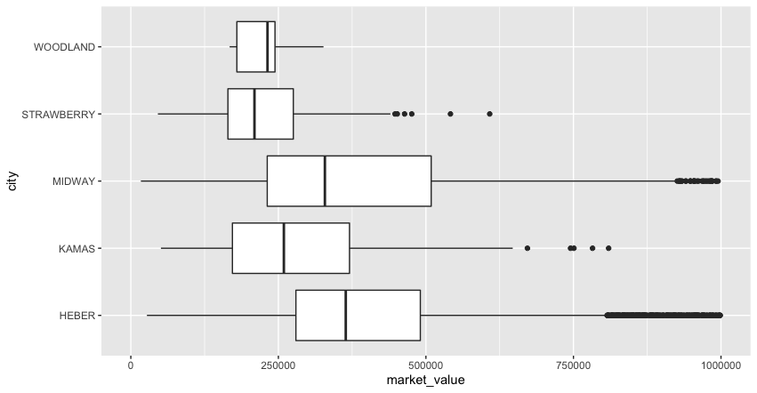
Boxplot
ggplot(houses) +
geom_boxplot(aes(x = city, y = market_value)) +
ylim(0, 1000000) +
coord_flip()
Notes:
You can really customize the look of these
What data might be hidden?

Slide 18
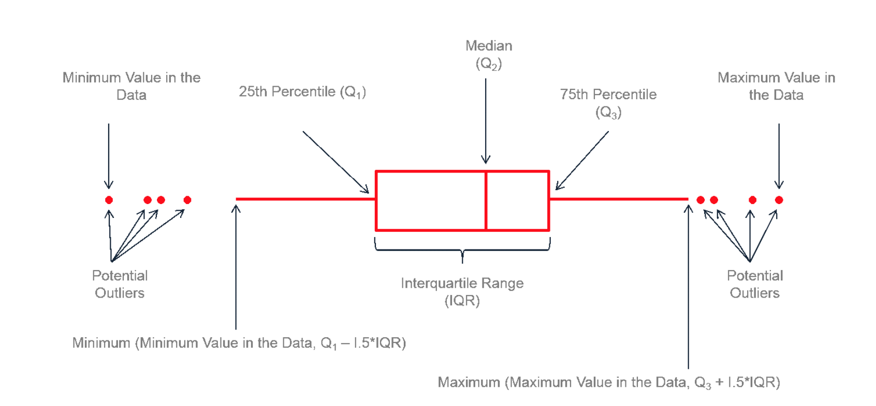
Anatomy of a Boxplot
Source: https://www.leansigmacorporation.com/box-plot-with-minitab/

Slide 19
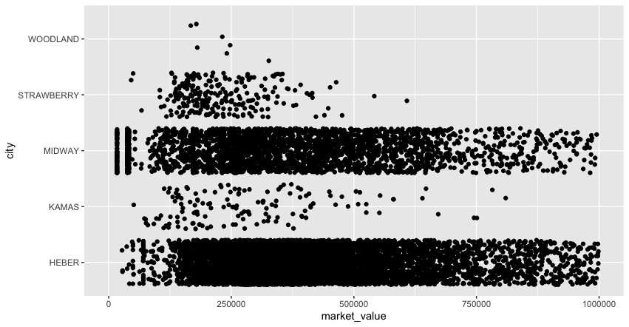
Jitter
ggplot(houses) +
geom_jitter(aes(x = city, y = market_value)) +
ylim(0, 1000000) +
coord_flip()
Notes:
What critical piece of information do all the previous visualizations lack? Sample size as a channel.

Slide 20
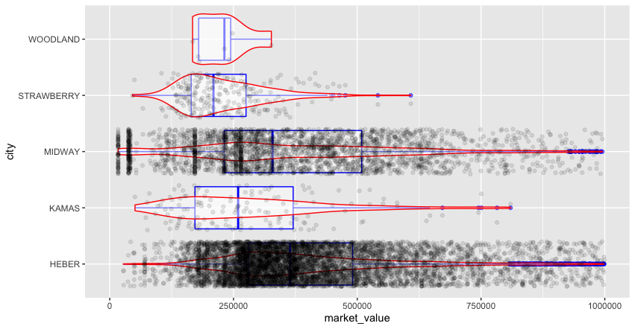
Frankenstein
ggplot(houses, aes(x = city, y = market_value)) +
geom_boxplot(alpha = .5, color = "blue") +
geom_violin(alpha = .5, color = "red") +
geom_jitter(alpha = 0.1) +
ylim(0, 1000000) +
coord_flip()

Slide 21
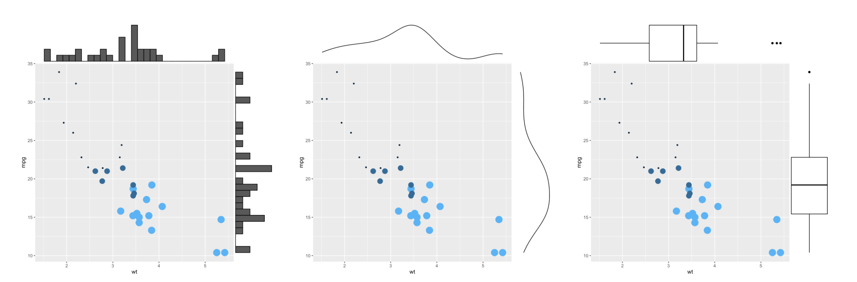
Combinations
Source: https://www.r-graph-gallery.com/277-marginal-histogram-for-ggplot2.html

Slide 22
Rug

Slide 23
‘Horrific’ typo valued Wasatch County home at almost $1 billion. Now taxpayers may end up paying for it
County officials apologize, say error ‘should have been caught’
Source: https://www.deseret.com/utah/2019/12/5/20997681/horrific-wasatch-county-error-valued-home-for-nearly-1-billion-now-taxpayers-may-have-to-pay-more

Slide 24
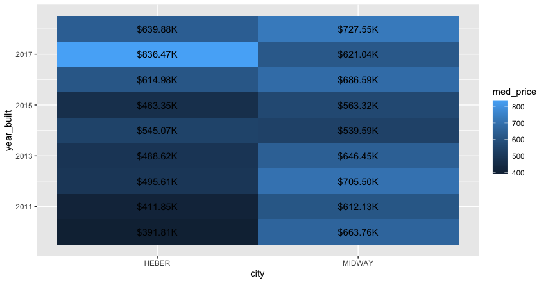
Heatmaps
houses %>%
filter(city %in% c("MIDWAY", "HEBER"),
year_built >= 2010,
year_built <= 2018) %>%
group_by(city, year_built) %>%
summarise(med_price = median(market_value)) %>%
mutate(med_price = med_price/1000) %>%
ggplot(aes(y = year_built, x = city, fill = med_price)) +
geom_tile() +
geom_text(aes(label = scales::label_dollar(suffix = "K")(med_price)))

Slide 25
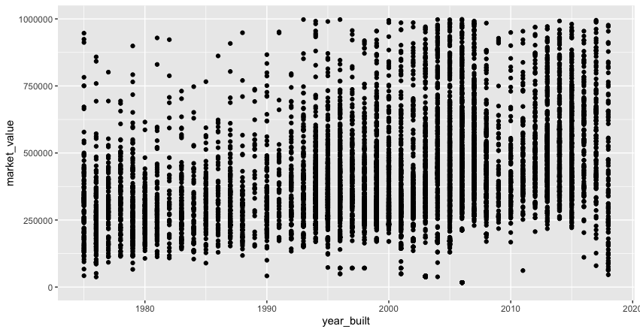
Scatter
ggplot(houses, aes(x = year_built, y = market_value)) +
geom_point() +
ylim(0, 1000000) +
xlim(1975, 2018)

Slide 26
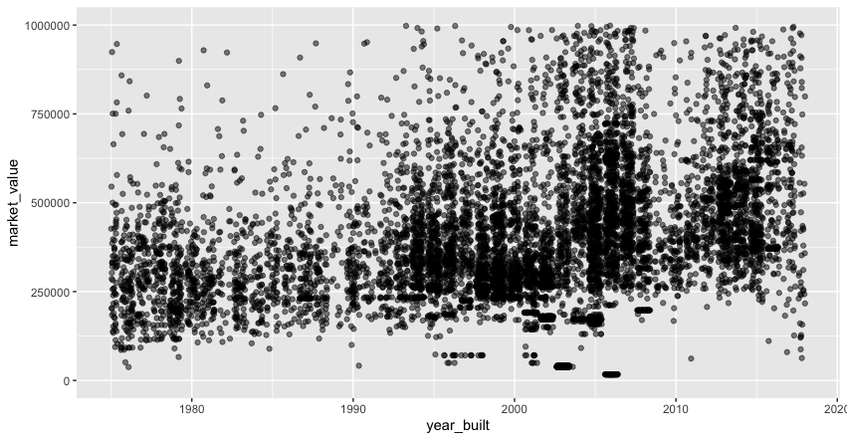
Jitter
ggplot(houses, aes(x = year_built, y = market_value)) +
geom_jitter(alpha = .5) +
ylim(0, 1000000) +
xlim(1975, 2018)

Slide 27
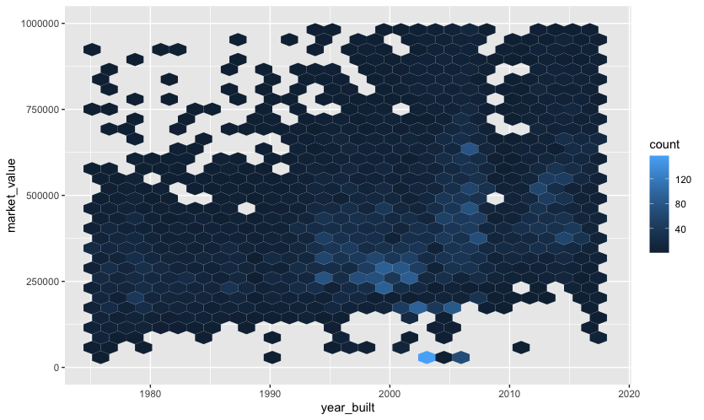
Hexbin
ggplot(houses, aes(x = year_built, y = market_value)) +
geom_hex() +
ylim(0, 1000000) +
xlim(1975, 2018)
Notes:
Customize the color and bin size

Slide 28
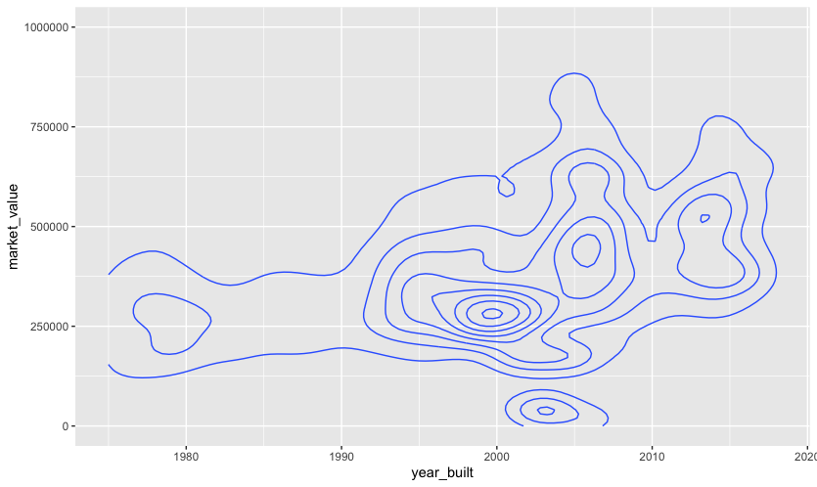
Contour
ggplot(houses, aes(x = year_built, y = market_value)) +
geom_density2d() +
ylim(0, 1000000) +
xlim(1975, 2018)

Slide 29
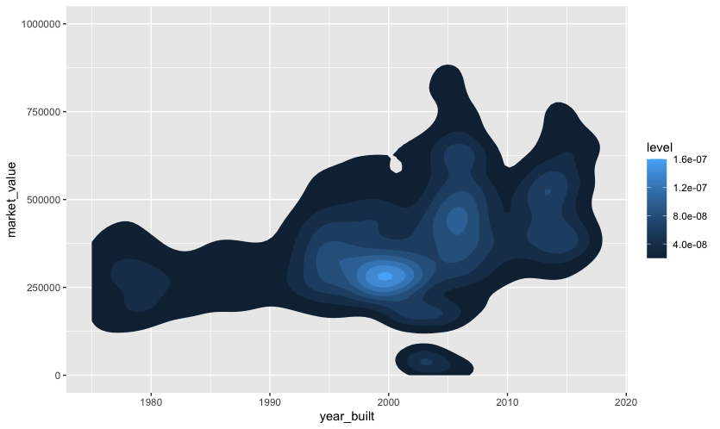
Density 2D
ggplot(houses, aes(x = year_built, y = market_value)) +
stat_density_2d(aes(fill = ..level..), geom = "polygon") +
ylim(0, 1000000) +
xlim(1975, 2018)

Slide 30
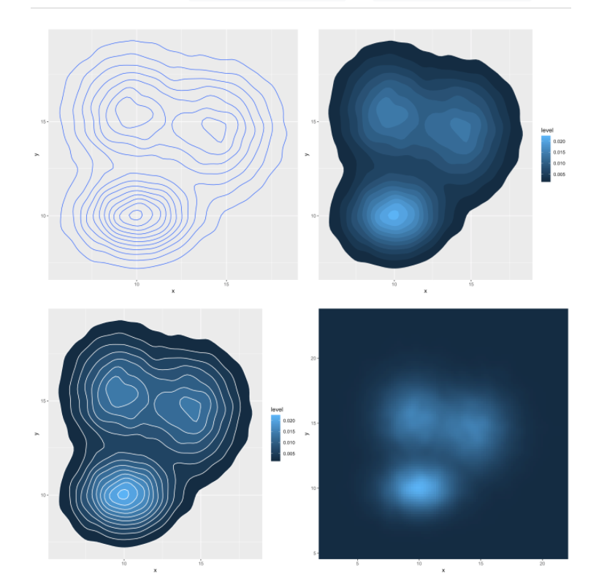
Customize it!
https://www.r-graph-gallery.com/2d-density-plot-with-ggplot2.html#distr

Slide 31
Eye Candy

Slide 32
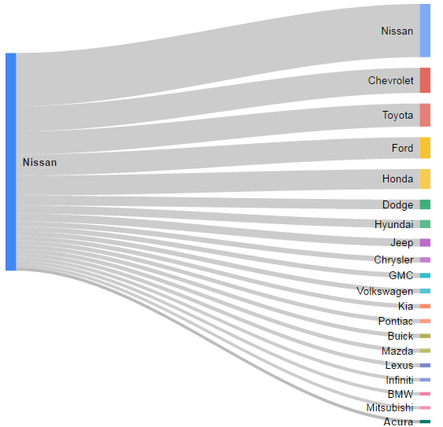
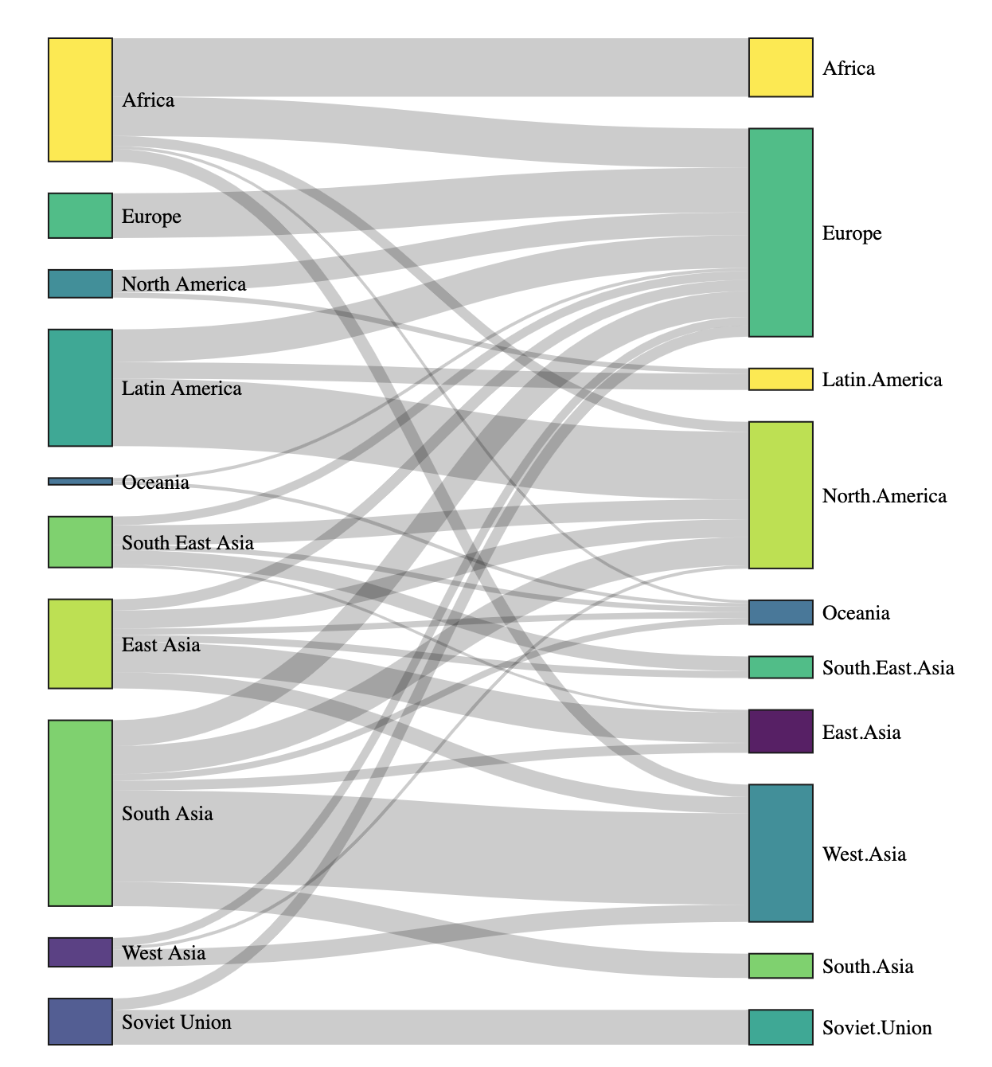
Sankey

Slide 33
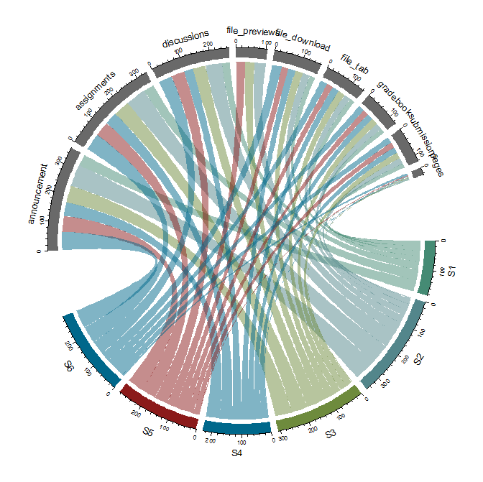
Chord
Notes:
Just a Sankey but with a polar axis

Slide 34
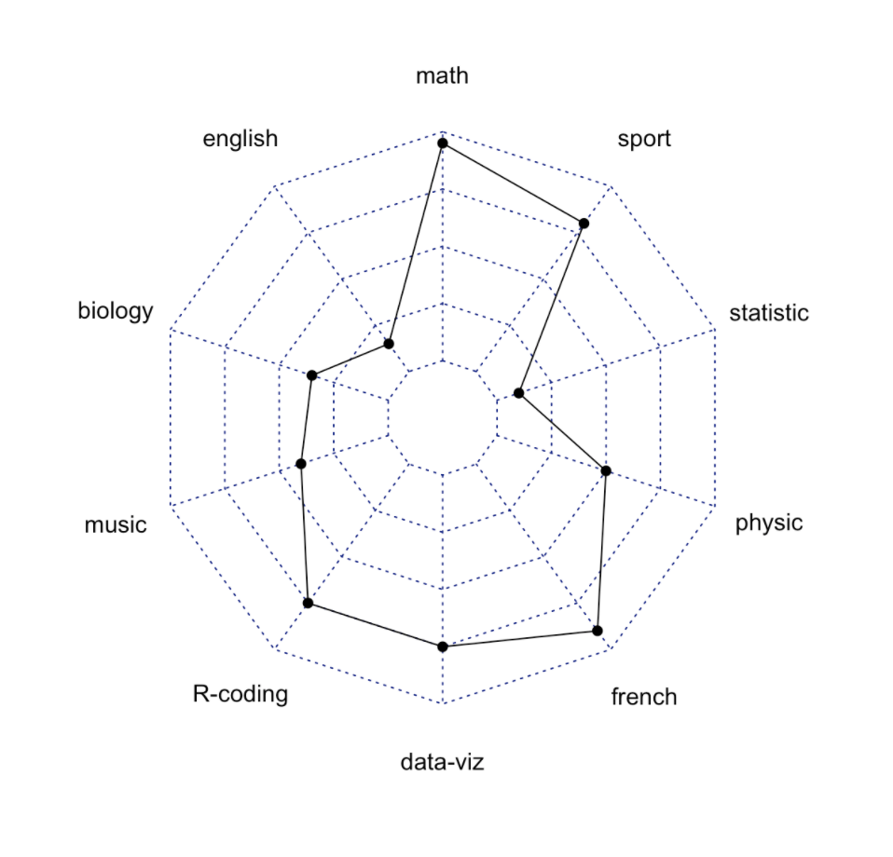
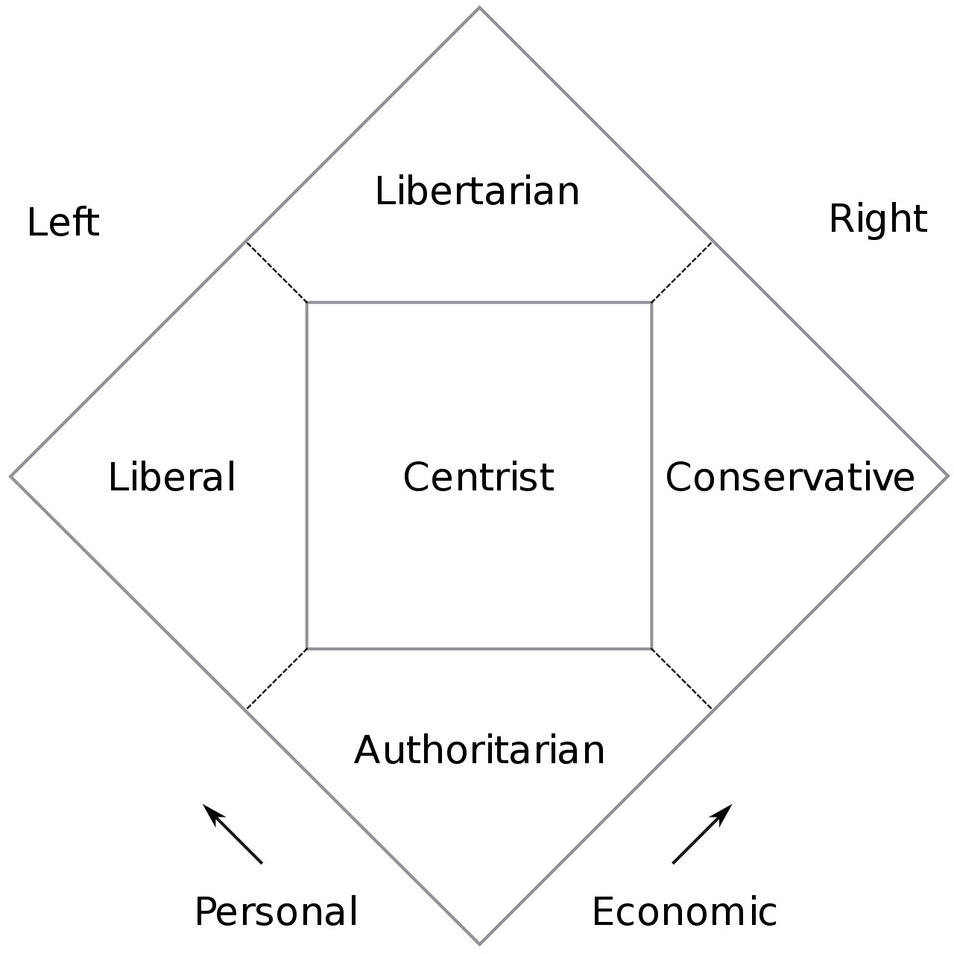
Radar
Also an eye candy chart
Common in politics and sociology
There is lots of criticism around this chart type – use it only if it makes sense

Slide 35
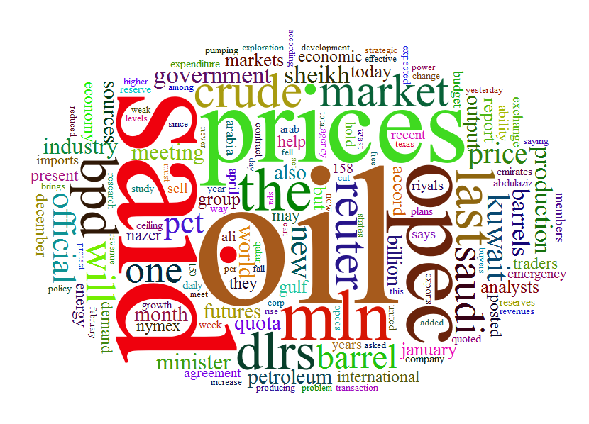
Word cloud
devtools::install_github("lchiffon/wordcloud2")
library(“wordcloud2”)
wordcloud2(demoFreq, size = 2, minRotation = -pi/2, maxRotation = -pi/2)
Cute effective eye-candy; client’s love these, but not very useful as a data viz
Dozens of free version tools exist online – wordle.net is my favorite; R code also words
Use familiar shapes
Use saturation as well as size for more frequent words
Ideally keep words horizontal

Slide 36
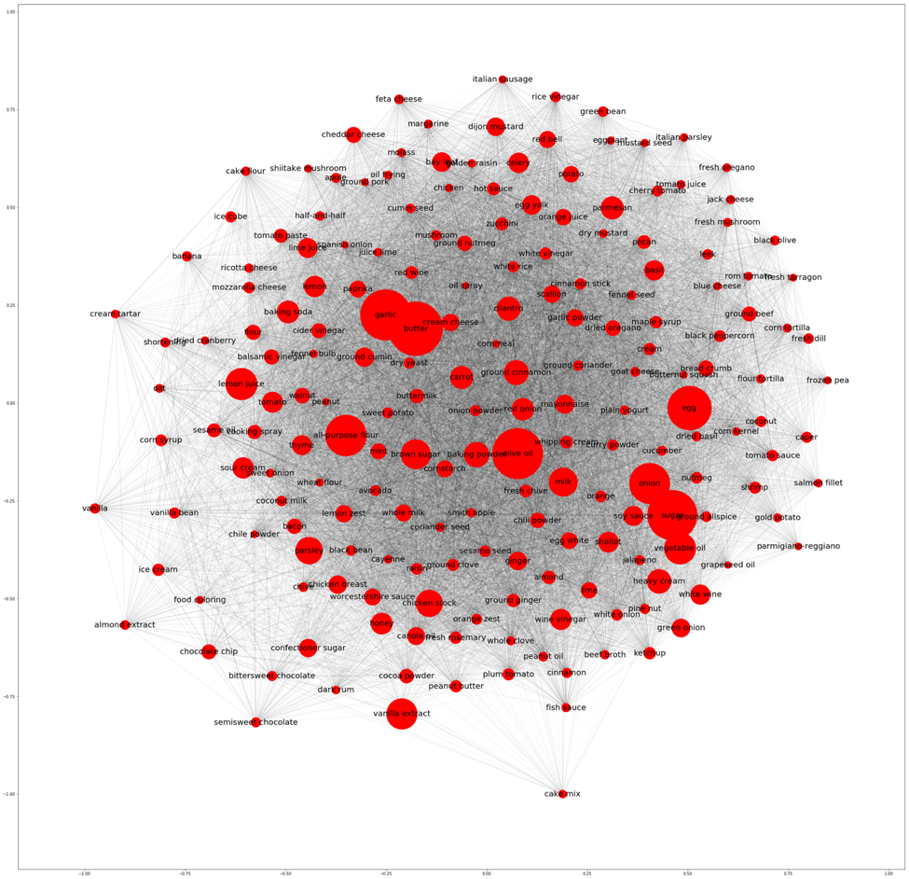
Network Graphs
Notes:
Hairballs

Slide 37
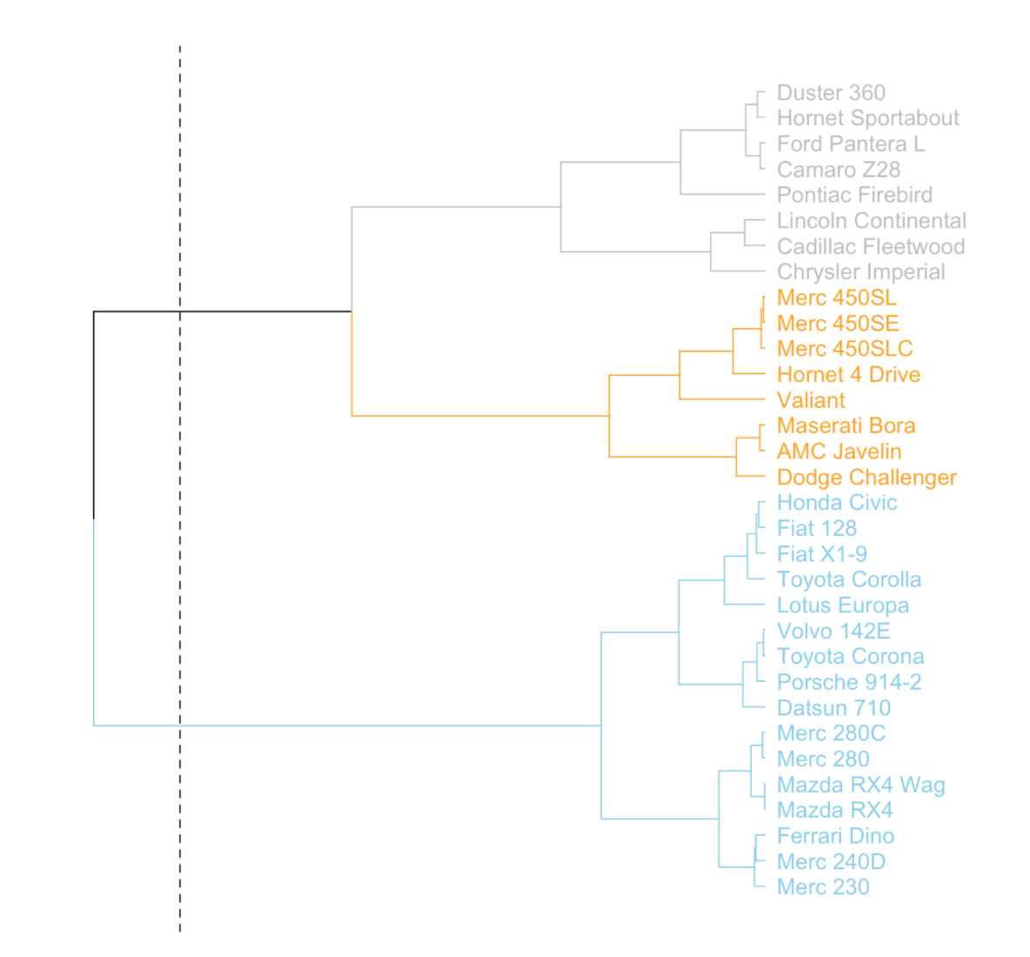
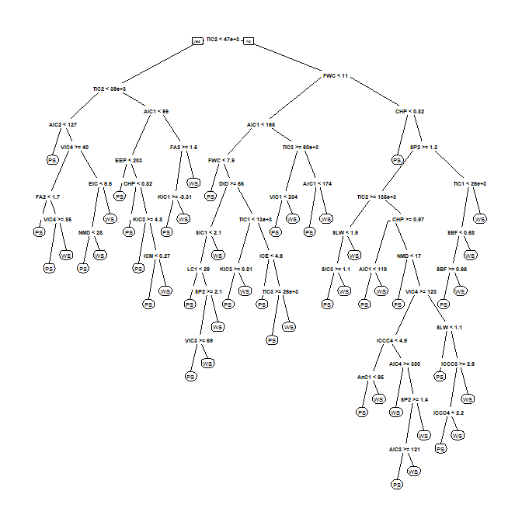
Dendrogram
Notes:
Used in decision trees
Be on the lookout for packages that include visuals to analyze the results (

Slide 38
Charts by Other Names

Slide 39
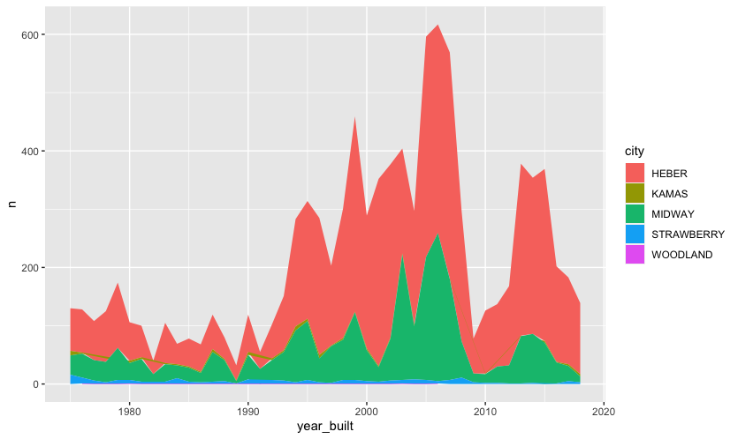
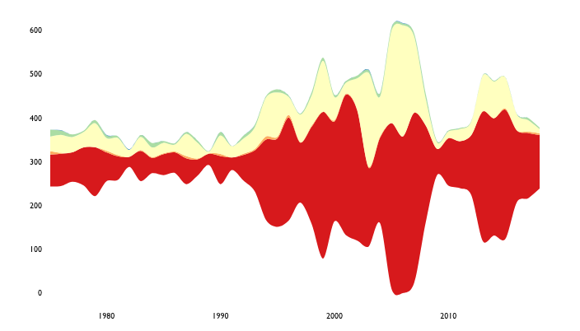
Streamgraph
devtools::install_github("hrbrmstr/streamgraph")
library(streamgraph)
houses %>%
count(city, year_built) %>%
filter(between(year_built, 1975, 2018)) %>%
streamgraph(key="city", value="n", date="year_built")
houses %>%
count(city, year_built) %>%
filter(between(year_built, 1975, 2018)) %>%
ggplot(aes(x = year_built, y = n, fill = city)) +
geom_area()
Stacked Area
Streamgraph

Slide 40
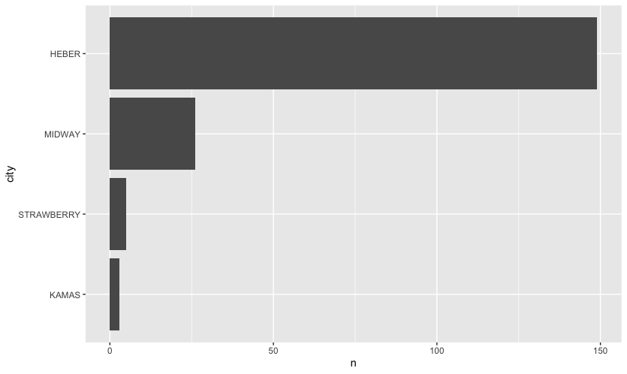
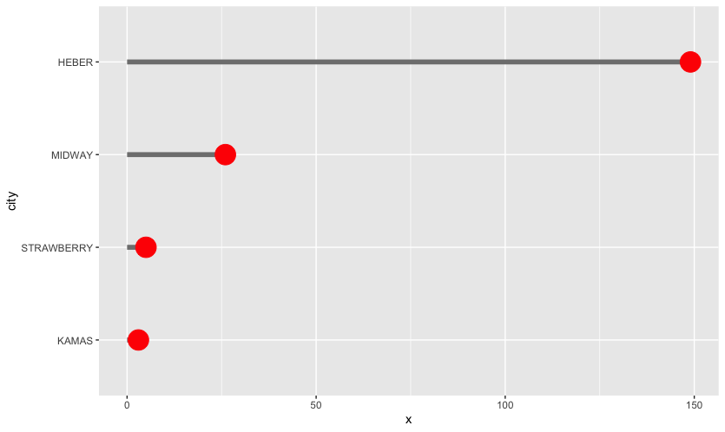
Lollipop
houses %>%
filter(year_built == 2017) %>%
count(city) %>%
arrange(n) %>%
mutate(city = fct_inorder(city)) %>%
ggplot() +
geom_segment(aes(x = 0, xend = n, y = city , yend = city), color = "grey50", size = 2) +
geom_point(aes(x = n, y = city), color = "red", size = 8)
houses %>%
filter(year_built == 2017) %>%
count(city) %>%
arrange(n) %>%
mutate(city = fct_inorder(city)) %>%
ggplot() +
geom_bar(aes(y = city, x = n), stat = "identity")
ggplot(houses) +
geom_bar(aes(y=city))
Bar Chart
Lollipop
Notes:
I always like the data to flow in the visual exactly as it should be displayed (e.g.., stat = identity). But ggplot does have some manipulations available, but with less control.

Slide 41
Homework

Slide 42
Homework 1
No Homework

